Slide 1
Lecture 04 Dynamic programming
Spring 2024
Zhihua Jiang

Slide 2
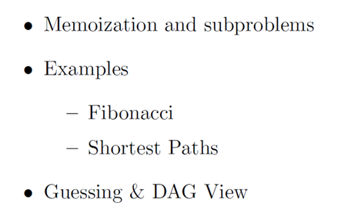

Slide 3
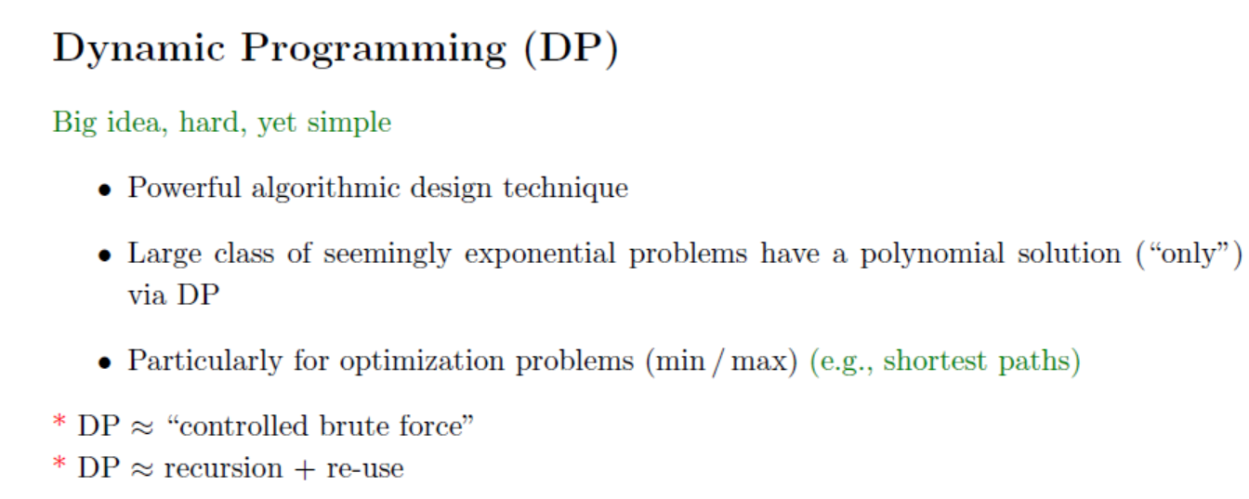

Slide 4
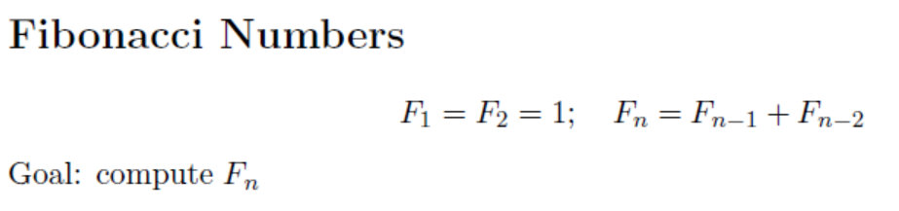
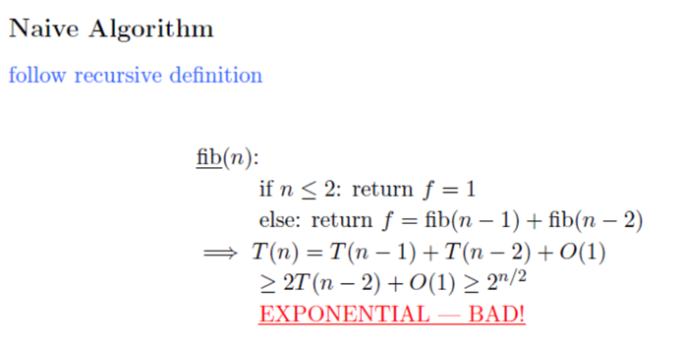

Slide 5
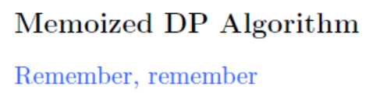
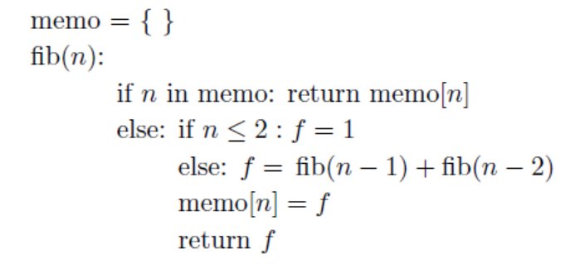
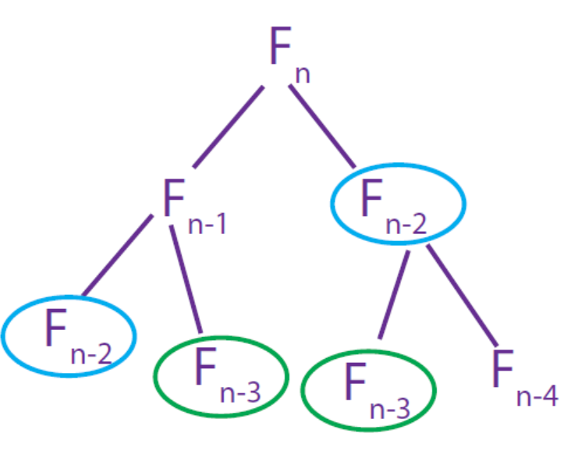

Slide 6
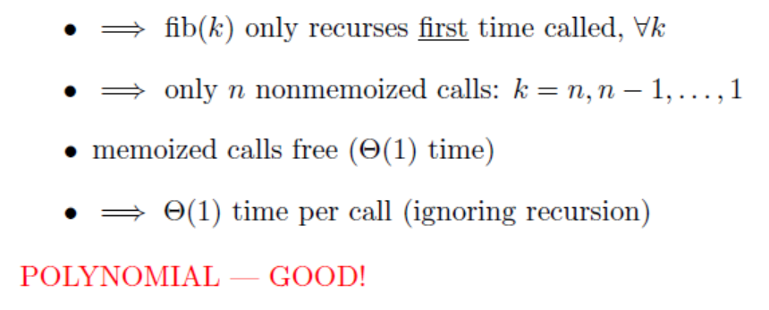

Slide 7
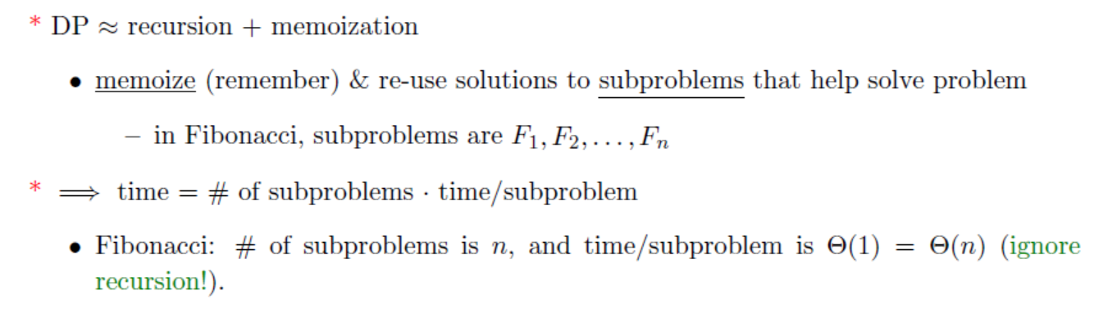

Slide 8
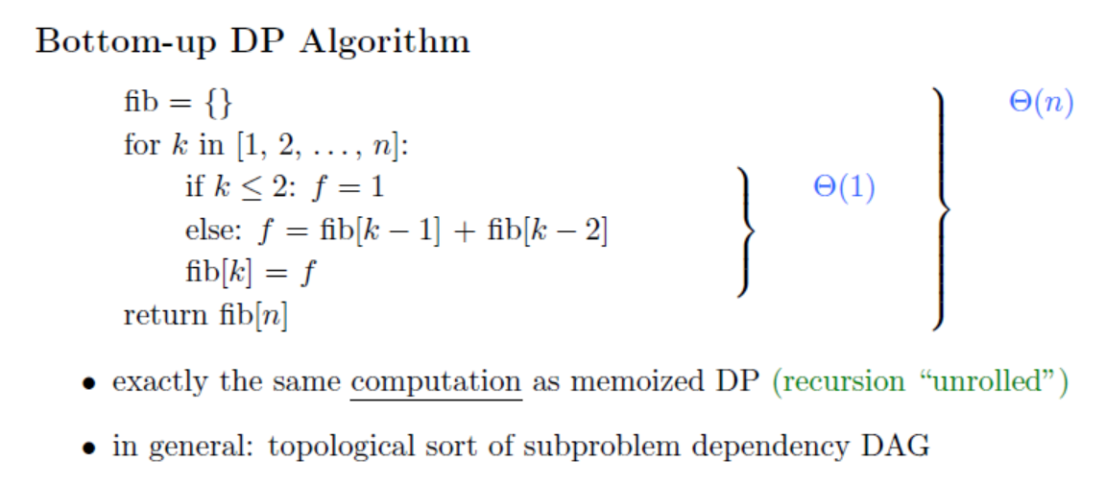

Slide 9
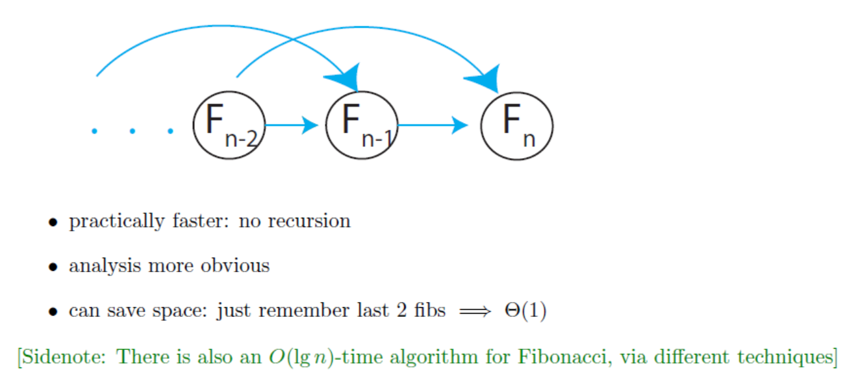

Slide 11
8
Notes:
flooring(n/2)=(n-1)/2

Slide 14
Chain matrix multiplication
Problem: multiply four matrices

Slide 15
Chain matrix multiplication
Matrix multiplication is associative.
Compute the product of four matrices in many different ways, depending on how parenthesize it.
Multiplying an m×n matrix by an n×p matrix takes mnp number multiplications.
The order of multiplications makes a big difference in the final running time.

Slide 16
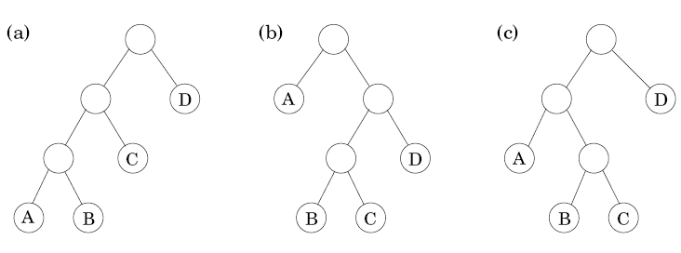
6.5 Chain matrix multiplication
How to determine the optimal order for A₁× A₂×… × A_{n}, where A_{i} with dimension m_{i-1}× m_{i}?
A particular parenthesization = a binary tree
Leaf: matrix
Root: product
Interior node: intermediate product
The number of binary trees is exponential in n (n leaves)
Notes:
#tree = (n-1)!=omega(2^(n-1))

Slide 17




Chain matrix multiplication
The optimal substructure property: for a tree to be optimal, its subtree must also be optimal.
Subproblem corresponding to a subtree: product of the form A_{i}× A_{i+1}×… × A_{j}
For 1≤i ≤j≤n, the optimal value array
C(i,j) = minimum cost of multiplying A_{i}× A_{i+1}×… × A_{j}
The splitting point k: split the product into two pieces, of the form A_{i}× … × A_{k} and A_{k+1}×… × A_{j}
The total cost is the cost of these two partial products plus the cost of combining them
子问题
找最优解（为子问题创建数组来保存最优解）
注意：此数组一般就是此算法的空间复杂度
写公式

Slide 18
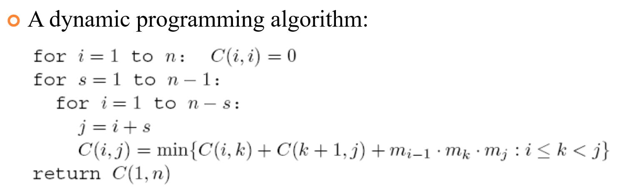
















Bottom up DP 动态规划自下而上
How to determine the optimal order for A₁× A₂×… × A_{n}, where A_{i} with dimension m_{i-1}× m_{i}?
求解子问题的循环式
别忘了初始化 initialization
子问题的值不能是未知值，需要有具体解。
S+1 = length(Ai,Aj)
Notes:
s=n-1 <-> i=1, j=n

Slide 19
Edit distance
The distance between two strings: the extent to which they can be aligned.
Example: SNOWY vs. SUNNY
Cost of an alignment: the number of columns in which the letters differ.
Edit distance: the cost of their best possible alignment, i.e., the minimum number of edits – insertions, deletions, and substitutions – needed to transform the first string into the second.
19

Slide 20
Edit distance
What are the subproblems?
Property: there is an ordering on the subproblems, and a relation that shows how to solve a subproblem given the answers to “smaller” subproblems, i.e., subproblems that appear earlier in the ordering.
Subproblem E(i,j): the edit distance between some prefix of the first string x[1..i] and some prefix of the second string y[1..j]
20

Slide 21
Edit distance
Smaller problems for E(i,j): E(i-1,j), E(i,j-1), E(i-1,j-1)
Try all and
Pick best!
21

Slide 22
Edit distance
Initialization 非常重要！！！！
A dynamic programming solution
Fill a table row by row, and left to right within each row
The time complexity: O(mn)

Slide 23
Edit distance
2024/4/8

Slide 24
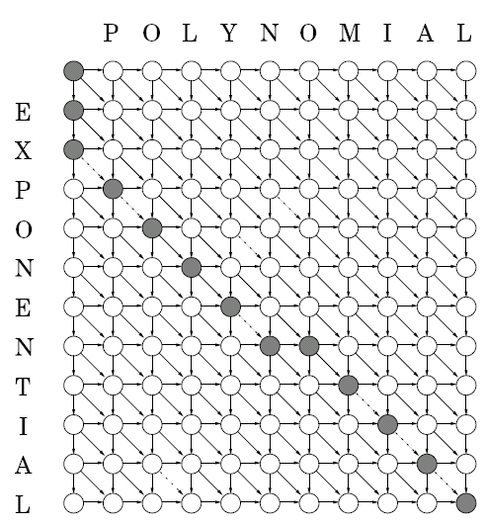
Edit distance
2024/4/8
Edits
Move down → deletion
Move right → insertion
Diagonal move → match or substitution

Slide 25
Knapsack
Problem description: a total weight W, n items to pick, of weight w₁,…, w_{n} and value v₁,…, v_{n} , what is the most valuable combination of items which can fit into the bag?
Example: W=10
Unlimited quantities of each item:
optimal solution $48
48 = 1 × #1+2 ×#4
One of each item:
optimal solution $46
46= 1 × #1+1 ×#3
#
#
#
#

Slide 26
Knapsack
Knapsack with repetition
Subproblem: smaller knapsack capacities w≤W
K(w)=maximum value achievable with a knapsack of capacity w
A dynamic programming solution (W and all w need to be integers):
The time complexity: O(nW)

Slide 27
6.4 Knapsack
Knapsack without repetition
Subproblem: smaller knapsack capacities w≤W and fewer items (items 1,2,…,j, for j≤n)
K(w, j)=maximum value achievable with a knapsack of capacity w and items 1,…,j
A dynamic programming solution:
The time complexity: O(nW)

Slide 28

Max{K(4)+30,K(7)+14,K(6)+16,K(8)+9}
Max{K(3)+30,K(6)+14,K(5)+16,K(7)+9}
Max{K(2)+30,K(5)+14,K(4)+16,K(6)+9}
w | 1 | 2 | 3 | 4 | 5 | 6 | 7 | 8 | 9 | 10
K(w) | 0 | 9 | 14 | 18 | 23 | 30 | 32 | 39 | 44 | 48
Max{K(0)+9}
Max{K(0)+14,K(1)+9}
Max{K(1)+14,K(0)+16,K(2)+9}
Max{K(2)+14,K(1)+16,K(3)+9}
Max{K(0)+30,K(3)+14,K(2)+16,K(4)+9}
Max{K(1)+30,K(4)+14,K(3)+16,K(5)+9}

Slide 29
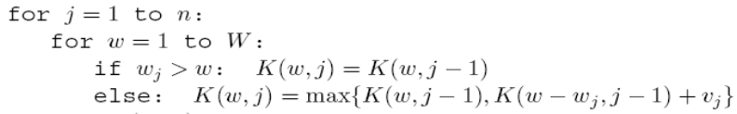
W j | 0 | 1 | 2 | 3 | 4 | 5 | 6 | 7 | 8 | 9 | 10
0 | 0 | 0 | 0 | 0 | 0 | 0 | 0 | 0 | 0 | 0 | 0
1 | 0 | 0 | 0 | 0 | 0 | 0 | 30 | 30 | 30 | 30 | 30
2 | 0 | 0 | 0 | 14 | 14 | 14 | 30 | 30 | 30 | 44 | 44
3 | 0 | 0 | 0 | 14 | 16 | 16 | 30 | 30 | 30 | 44 | 46
4 | 0 | 0 | 9 | 14 | 16 | 23 | 30 | 30 | 39 | 44 | 46
c

Slide 30
Independent sets in trees
Dependent set: subset of nodes S ⊂ V, and there are no edges between them
Finding the largest independent set in a graph is intractable
However, it can be solved in linear time when the graph is a tree, using dynamic programming
Algorithm:
Start by rooting the tree at any node r. Each node defines a subtree.
The goal is I(r):
I(u) = size of largest independent set of subtree hanging from u
If know I(w) for all descendants w of u, then compute I(u):

Slide 31
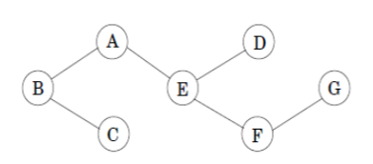
Independent sets in trees
The number of subproblems: O(|V|)
The running time: O(|V|+|E|)
I(G)=1
I(D)=1
I(F)=max{1,1}=1
I(E)=max{1+1,1+1}=2
I(C)=1
I(A)=max{1+2,2}=3
I(B)=max{1+2,3+1}=4
Notes:
left: pick itself
right: pick all children

